Slide 1

System Stored Functions
Thomas Vo
Anthony McJunkins
Cynnetha Bellinger
Ying Fang

Slide 2

What is a System Stored Function?
A SQL stored procedure (SP) is a collection SQL statements and sql command logic, which is compiled and stored on the database.
(SP) in SQL allows us to create SQL queries to be stored and executed on the server.
The main purpose of (SP) are to hide direct SQL queries from the code and improve performance of database operations such as select, update, and delete data.
Accelerate the execution of SQL queries.

Slide 3
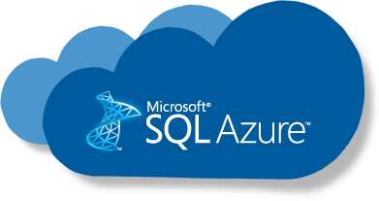
There are two types of stored procedures available in SQL:
User defined stored procedures
- Contains one more more SQL statements to select, update, or delete records from database tables.
- Take input parameters and return output parameters.
- Mixture of DDL (Data Definition Language) and DML (Data Manipulation Language ) commands.
System procedures procedures
- Created and executed by SQL Server for the server administrative activities. Developers usually don't interfere with system SPs.

Slide 4

T-SQL (Transact SQL)
-Receive and returns parameters. These SPs process the Insert, Update and Delete queries with or without parameters and return data of rows as output. One of the most common ways to write SPs in SQL Server.
CLR (Common Language Runtime)
-Written in a CLR based programming language such as C# or VB.NET and are executed by the .NET Framework.

Slide 5
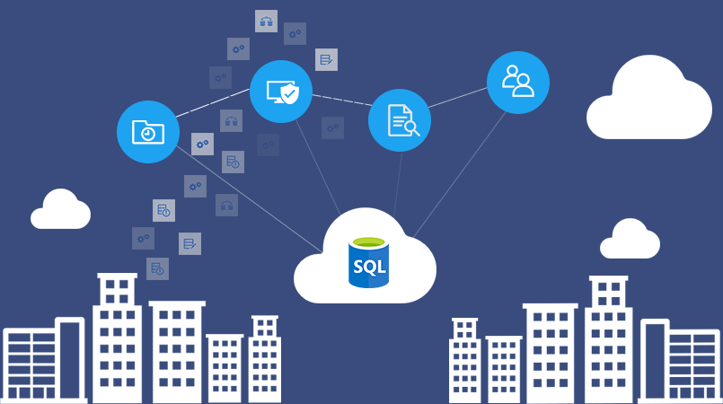
SQL Azure Linked
Sql server
SQL Server
oracle
Client Application
Oracle
odbc
Client Tier
Server Tier
Database Server Tier

Slide 6

Creating Stored Procedures
Stored procedures provide some crucial benefits, which are:
Reusable: Multiple users and applications can easily use and reuse stored procedures by merely calling it.
Easy to modify: You can quickly change the statements in a stored procedure as and when you want to, with the help of the ALTER TABLE command.
Security: Stored procedures allow you to enhance the security of an application or a database by restricting the users from direct access to the table.
Low network traffic: The server only passes the procedure name instead of the whole query, reducing network traffic.
Increases performance: Upon the first use, a plan for the stored procedure is created and stored in the buffer pool for quick execution for the next time.

Slide 7
How to Create a Stored Procedure
Shortcut for stored procedure can be accesed in Programmability folder.
In Azure, use file menu to create a new query
Template for stored procedure will be created. Any parameters can be added to it.
Typing ‘Create” gives you option to create a stored procedure
Hit Run to store procedure.

Slide 8

Functions VS. Stored Procedures
Only return 1 value which is mandatory
Only supports an input parameter
Can’t be called from an SP
Can be used in a join clause
Can be called from select statements
Can’t fire triggers
DML and DDL Operations can’t be performed. Can only use Select and Insert statement in a variable table.
Can’t be run indepently
Used to compute a value.
SP can return 0, single or multiple values.
Have n input/output paramter
Can call a function.
Cannot be used in a join clause
Cannt be called from select statements.
Can fire triggers.
DML and DDL operations can be performed.
Can run independently using Exec command.
Used to perform a specific task.

Slide 9
Functions Vs Stored Procedures
Functions can be invoked within a procedure.
Procedures can be called within a procedure.
Procedures and functions can be invoked inside another procedure.
Functions can be invoked inside of other functions.

Slide 10
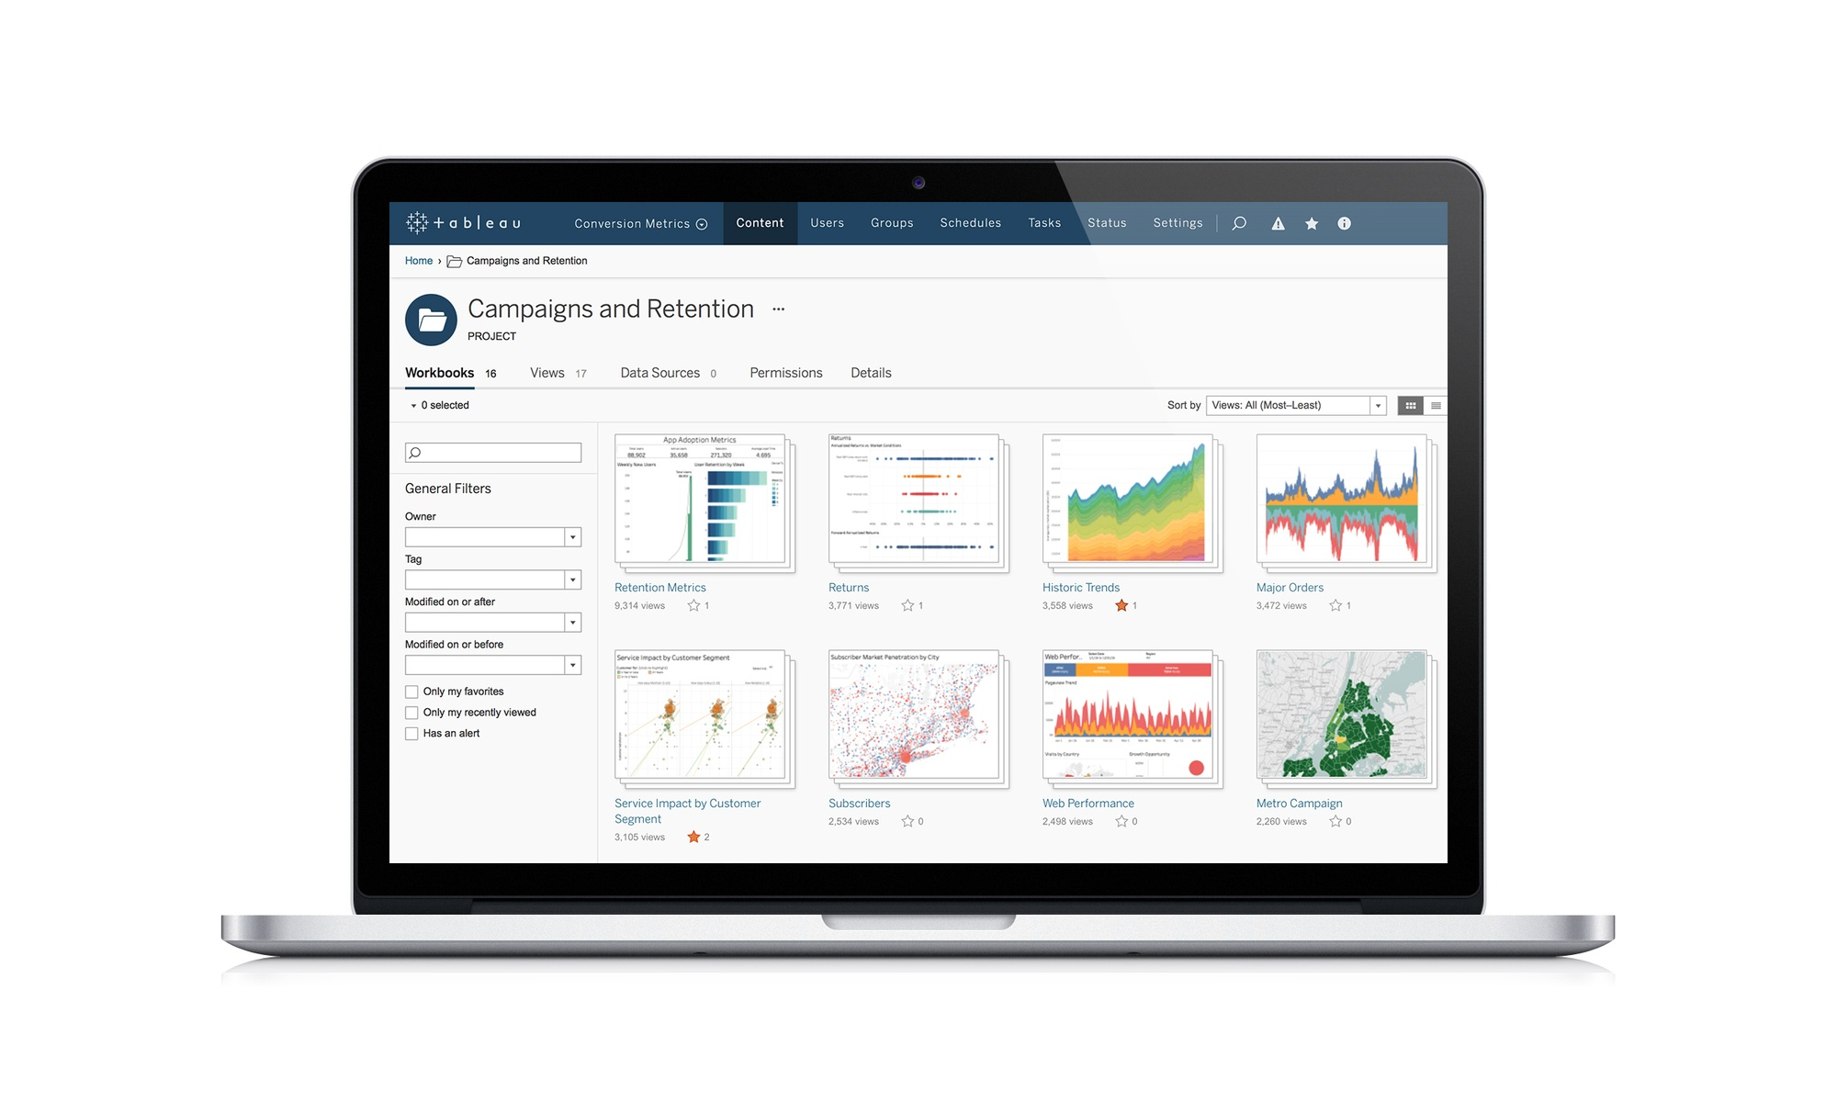
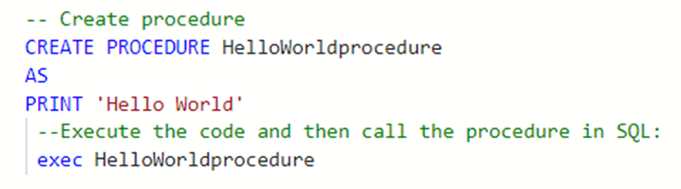
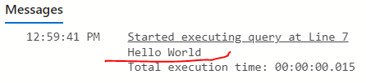
Functions Vs Stored Procedures

Slide 11
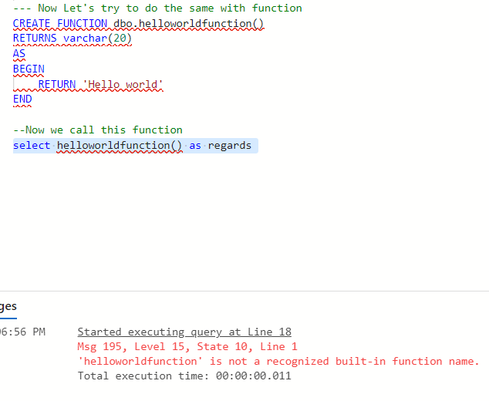
Functions Vs Stored Procedures

Slide 12
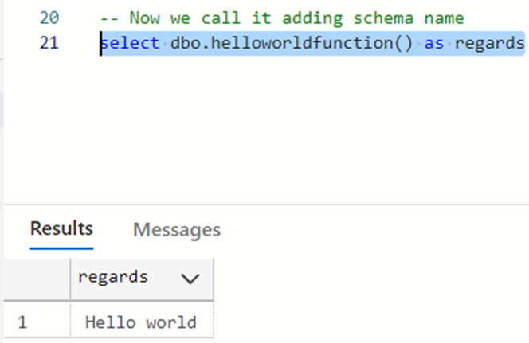
Functions Vs Stored Procedures

Slide 13
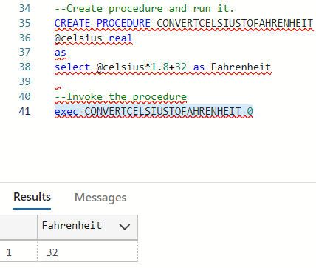
Functions Vs Stored Procedures

Slide 14
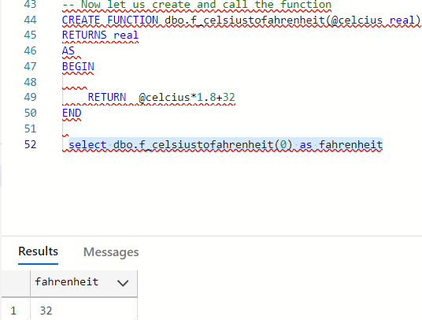
Functions Vs Stored Procedures

Slide 15
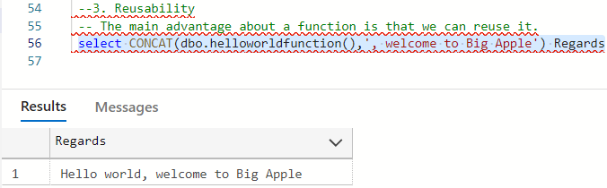
Functions Vs Stored Procedures

Slide 16
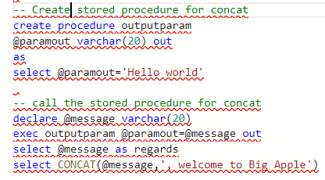
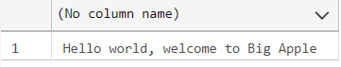
Functions Vs Stored Procedures

Slide 17


